Slide 1

Greedy algorithms for shortest path
Ivy Truong

Slide 2
Description of Algorithms
Dijkstra’s Algorithm
Prim’s Algorithm
Finds the shortest path to all nodes starting from the first visited node/start node
Relaxation: visiting all neighboring nodes of the current visited node
Time complexity: O(E log V)
Find the minimum spanning tree that visits all nodes
Finds the shortest path to a neighboring node that is not in the MST
Time complexity: O(E log V)

Slide 3
Similarities and Differences between both Algorithms
Similarities
Dijkstra’s
Prim’s
Paths are simple with no cycles
Works with undirected and directed graphs
Cannot handle negative weights on edges
Determines shortest path in respect to the start node
Can handle negative weights on edges
Determines a minimal path based on the path between neighboring nodes

Slide 4
Dijkstra’s Algorithm Process
First thing to do is to is to choose a node that will be the starting node. This is where all the paths to all other nodes on the graph will start. Then set the distance to all other nodes on the graph to infinity.
1. Choose the smallest edge from the paths that lead to the current visited node’s neighbors.
2. Relax the edge. This means the algorithm will choose the edge with the minimum cost starting at the start node to the neighboring node.
a. If the chosen edge has a cost less than the current minimum cost to that neighboring node, update it. The cost to the neighboring node will update to the minimum cost and the previous node needed to reach to the neighboring node is updated.
i. If the cost is infinity, replace the cost with the cost taken to reach the node.
ii. If the cost is not infinity, update the cost by adding the cost to the current cost and updating the previous node value. The previous node value is used to keep track of the previous path the algorithm took before reaching the neighboring node.

Slide 5
Dijkstra’s Algorithm Process (continued)
2. Relax the edge. (continued)
b. If the chosen edge does not have a cost less than the current minimum cost to that neighboring node, the minimum cost is not updated.
3. Move on to the next smallest edge for the current visited node. Repeat steps 1 and 2 until all the edges for the current node have been relaxed.
4. To choose the next node to visit, choose the neighboring node that has the smallest cost to take the path. Then repeat steps 1 through 3 for the new currently visited node.
5. Repeat steps 1 through 4 until all edges have been relaxed. This concludes the algorithm.

Slide 6
Prim’s Algorithm Process
Choose a random node in the graph to start off creating the minimal spanning tree. This is the first visited node from the graph and will be included in a list to keep track of the visited nodes in the graph/nodes part of the MST.
1. To choose where to go, choose the edge with the smallest cost out of all the edges that is connected to all the visited nodes so far.
2. Check to make sure that the edge taken does not visit a node that is already in the MST.
a. If the node has already been visited, discard the current edge as the smallest edge and repeat step 1 by finding the next smallest edge in the list of edges that are connected to the nodes in the list of visited nodes.
b. If the node has not been visited, do the following. Record the edge as the smallest edge taken to get to the neighboring node. Record the source node, the destination node, and the edge cost. Include this information as part of the minimal spanning tree path.
3. Repeat steps 1 and 2 until all nodes in the graph are part of the MST.

Slide 7
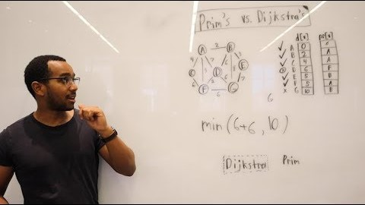
Awesome Resource!!
Link: https://www.youtube.com/watch?v=K_1urzWrzLs

